Slide 1

Beyond SARCASTIC:
Closing the Gap to Ansys
Notes:
Framing slide. State the goal in one sentence -- generate physically-grounded SAR raw data (and images) from an authored 3D scene, for algorithm testing / training data / detector development, without needing a real collection.

Slide 2




MOTIVATION
Why simulate Synthetic Aperture Radar (SAR) from a 3D scene?
Real collections are expensive and access-restricted
Ground truth you can’t get from real data
Sparse in target diversity; hard to get controlled variety
Exact target pose, position, and material -- known, not estimated
Controlled experiments
Feeds detector / Automatic Target Recognition (ATR) development
Vary geometry, aspect angle, material, and clutter independently
Synthetic training data augmentation, e.g. target injection into real clutter
Notes:
This motivates the whole pipeline -- it’s not "make pretty radar pictures," it’s "generate raw phase history with known, controllable ground truth."

Slide 3
MOTIVATION, CONTINUED
Concrete use cases: who runs this, and for what
Beyond the general motivation (previous slide): three places a controllable, ground-truthed SAR forward model earns its keep in practice.
ATR & Detection
Algorithm Development & Test
Mission Planning & Sensor Trade Studies
Training data augmentation via target injection into real clutter -- covers rare target classes/poses real collections can't supply on demand
Model-based / matched-filter detection templates – simulated model double as the detector's reference signature
Synthetic scenario generation for analyst training and benchmark construction, with exact ground-truth labels no manual annotation can match
Ground Moving Target Indicator (GMTI) -- exercise a mover detector against known-truth radial velocity and clutter notch before recording live multi-channel data
Change-detection algorithm testing -- paired before/after scenes with exactly known ground-truth changes, on demand
Image-formation / autofocus validation
Pre-fly the collection plan to find what actually resolves the target before spending real tasking budget
Real commercial tasking runs roughly $1300-$7000 per scene (Airbus/Astrium GEO TerraSAR-X price list) vs. seconds per simulated pass on a Graphical Processing Unit (GPU)-- cheap enough to optimize collection value first
Sensor design trade studies -- bandwidth/resolution choice before committing to hardware
Notes:
Deliberately distinct from the previous slide's "why simulate at all" framing -- this is "who specifically uses it and for what," so it should survive a "sure, but what would you actually use it for" follow-up question. The tasking cost figures are from Airbus/Astrium GEO's published TerraSAR-X International Price List (2011 issue, the most granular public one available) -- new-acquisition scene prices run €1,375 (StripMap, 3m) up to €6,750 (High-Resolution SpotLight, 1m), with 90-day archive data at roughly half that; more recent retail quotes for other resolution/urgency combinations run higher (up to €13,500 for rush high-res tasking), so €1,375-€6,750 is a defensible, sourced floor-to-typical range rather than a worst-case. The "pre-fly the collection plan" point is the sharpest version of the economic argument: it's not just that simulated collects are cheaper than real ones, it's that simulation lets you find the standoff/altitude/resolution combination that actually resolves the target of interest BEFORE spending real tasking budget on a collect that might turn out to have the wrong geometry -- exactly the standoff/altitude/depression-angle tuning this deck's own Tier 2 validation collect went through this session (accidentally grazing incidence at one point, corrected before the final run).

Slide 4
LANDSCAPE
Simulation Classes & Gap Analysis
Class | Physics | Scene scale | Polarization / examples
Full-wave (Method of Moments / Finite Element Mesh) | Exact numerical Maxwell solve on the meshed surface | Electrically small objects only (a few λ) | Full vector, exact — FEKO MoM, HFSS FEM
Discrete-target Shooting/Bouncing Rays (SBR) + PTD | SBR + physical optics (PO) + physical theory of diffraction (PTD) + rigorous multi-bounce on a fine mesh | One target at a time — cost explodes with object count / scene size | Full vector, per-material — XPatch
Scene-scale SBR (Gaming Engine World Creation) | Same ray-tracing core, relaxed: coarser mesh, PO only, PTD usually dropped | Whole environments — terrain + many objects, tractable runtime | Usually scalar / single real vector — SARCASTIC, RaySAR, MATLAB
Parametric / Attributed Scattering Center (ASC) – Geometric Theory of Diffraction (GTD) | Closed-form fit to scattering-center parameters — not a first-principles solve | Wherever it was fit (bounded aspect / frequency sector) | Inherits whatever generated the fit — Potter & Moses
Empirical / statistical clutter | Measured or regression backscatter statistics, no geometry | Any area, cheaply — no scene-specific structure | Per-channel σ⁰ only, no coherent phase — Barton, GIT, Billingsley, Oh/IEM
Dense SBR + UTD | SBR + physical optics (PO) + Uniform Theory of Diffraction (UTD) + rigorous multi-bounce on a fine mesh | Open world with moving actors (current Gold Standard) | Ansys Perceive EM/SBR+
Can we combine approaches to get close to Ansys with lower cost/compute?
Notes:
Landscape slide -- positions everything discussed so far (SBR substrate, ASC, Sinclair-matrix polarimetry, empirical clutter) against the broader field, including tools not otherwise mentioned (XPatch, MoM solvers). Sets up the gap-analysis slide immediately following.

Slide 5
POSITIONING
The goal isn’t to beat Ansys -- it’s to get close, for less compute
Ansys Perceive EM/SBR+ already does dense multi-bounce ray tracing with per-bounce polarimetric materials, plus PTD/UTD diffraction and creeping waves. That’s a mature, commercial, full-featured solver -- this pipeline does not out-perform it on physics.
THE ACTUAL CLAIM
THE HONEST GAP
Close to dense SBR accuracy, for a fraction of the AMORTIZED compute -- ASC caches the expensive part once per structure and reuses it across every pulse, aspect, and scenario
The win only shows up at scale -- not for a single one-off look
Diffraction (PTD, creeping waves) -- Ansys models it, this pipeline currently doesn’t
Near-field coupling between adjacent structures -- structurally invisible to a per-structure closed-form cache, not a bug to fix
Gap is measured, not assumed -- quantified via the dense-SBR-vs-ASC regression suite (validation section)
Bottom line: this is an engineering tradeoff claim -- most of the accuracy that matters for target use cases, with a lower amortized cost, with the gap stated precisely enough to defend in a room that knows Ansys.
Notes:
This slide exists because of a direct pressure-test: does Ansys SBR+ already do full polarimetric multi-bounce with dense rays? Yes, confirmed against Ansys documentation (MBRDC ray density control, PO/GO hybrid with PTD/UTD diffraction). The honest answer is this pipeline is not novel relative to commercial SOTA -- it is a lower-cost, amortized-compute approximation of it, with a specific and measurable gap. State this plainly rather than let an interviewer who knows HFSS catch it.

Slide 6

GOTCHA
Why is Ansys so computationally expensive?
Whether a double/triple-bounce path exists and points at the sensor depends on platform position -- re-run SBR at every synthetic aperture position, not once
Cost: O(pulses × rays × bounces)
Brute-force ray density can under-sample the narrow specular-alignment condition that makes a dihedral bright -- easy to get an artificially dim building edge
Notes:
Good slide to pause on -- it’s the most likely place a first implementation silently produces wrong-looking results (dim buildings) without erroring. Sets up the speedup slide that follows directly.

Slide 7
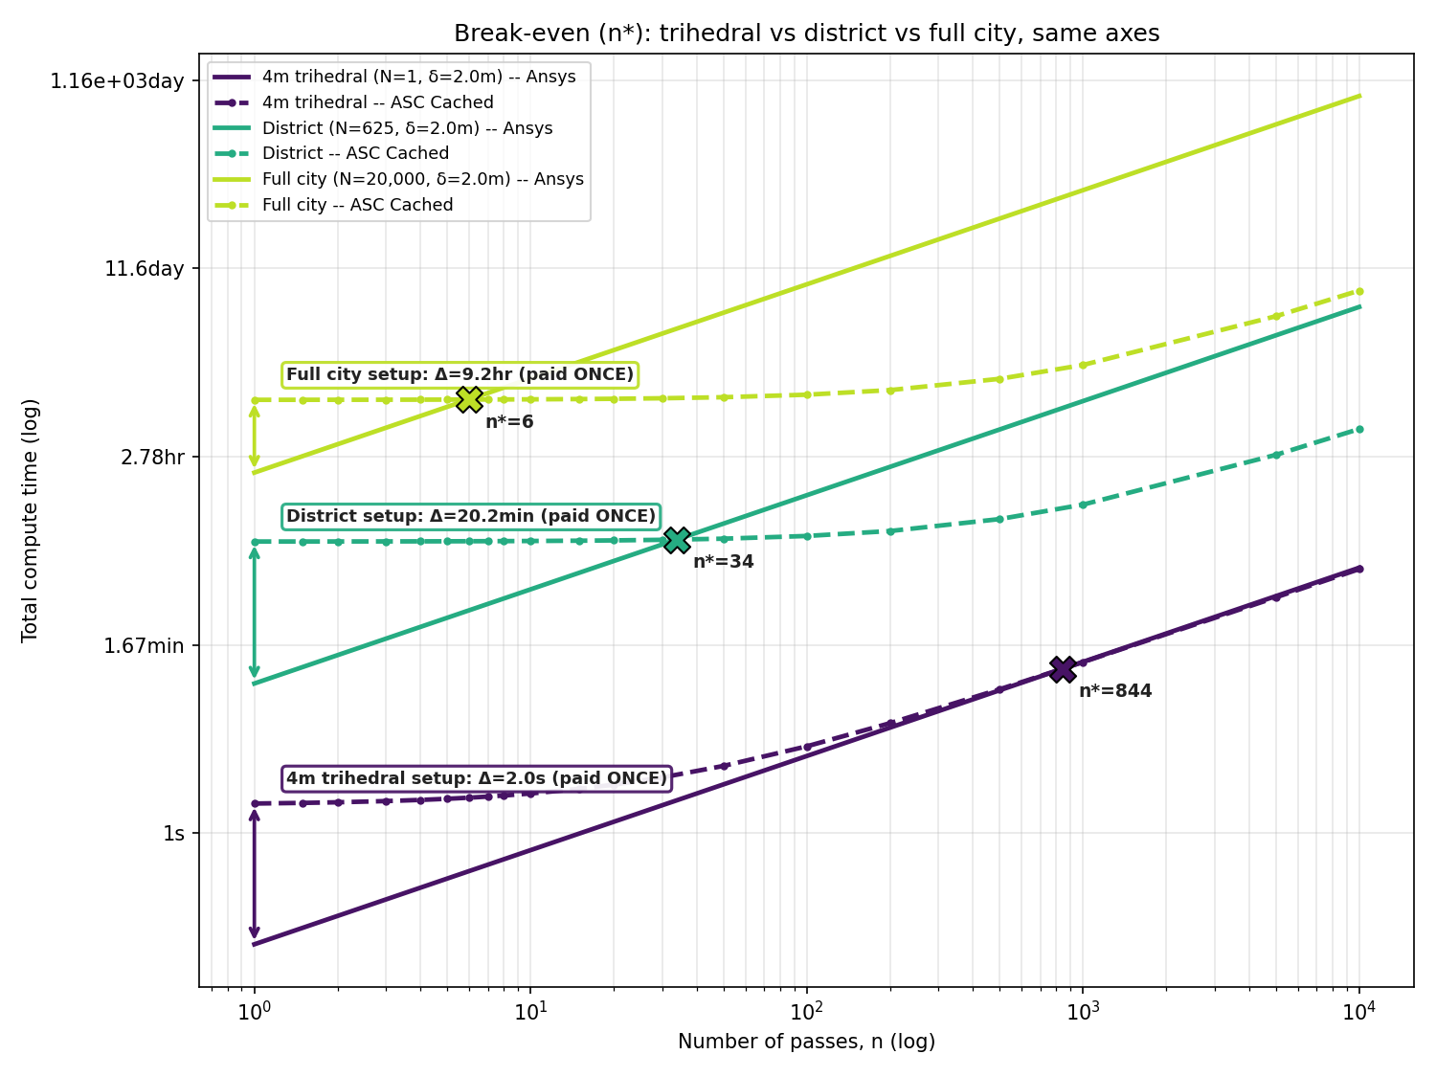
COST TRADEOFF
The ASC build cost is real -- how many passes to pay it off?*
Same sensor mode / resolution (2m Ground Sample Distance (GSD), real TerraSAR-X Spotlight) at every scale -- what changes is the footprint, so pulse count scales with it. n* = number of collects before ASC-cached total cost undercuts Ansys.
BREAK-EVEN, BY SCALE
4m^2 trihedral (N=1): n*=844 collects -- a one-off cal target essentially never pays back on its own
District (N=625): n*=34 collects -- amortizes within a modest revisit campaign
Full city (N=20,000): n*=6 collects -- pays for itself almost immediately at city scale
Bottom line: the ASC library isn’t worth building for a single isolated target -- it’s a scale play. Build it once per structure, reuse it across every collect, scenario, and aspect that touches that structure.
*Both approaches estimated on the same single desktop/laptop-class Graphics Processing Unit (GPU), not a cluster, 75µs for Ansys per structure
Notes:
Fermi-estimate quality, same caveat class as the other worked-example slides. Model: resolution held FIXED at 2m across all three scales (not re-tuned per scene -- that was an earlier, physically wrong draft: a 4m trihedral imaged at 20m GSD would be lost in clutter, since clutter power scales with resolution-cell area while target RCS is fixed). Pulse count instead scales with imaged footprint, assuming uniform structure density so footprint linear extent ~ sqrt(N); grounded at the real TerraSAR-X anchor (~4,497 pulses for the full 10km x 10km city at 2m). Build cost uses the worst-case B=2 sec/structure (blended ray-trace+classify+ML-fallback). n* is independent of platform/orbit choice given these assumptions -- it is NOT independent of the footprint-scaling assumption itself, which is the weakest-grounded piece here and worth saying so if asked.

Slide 8
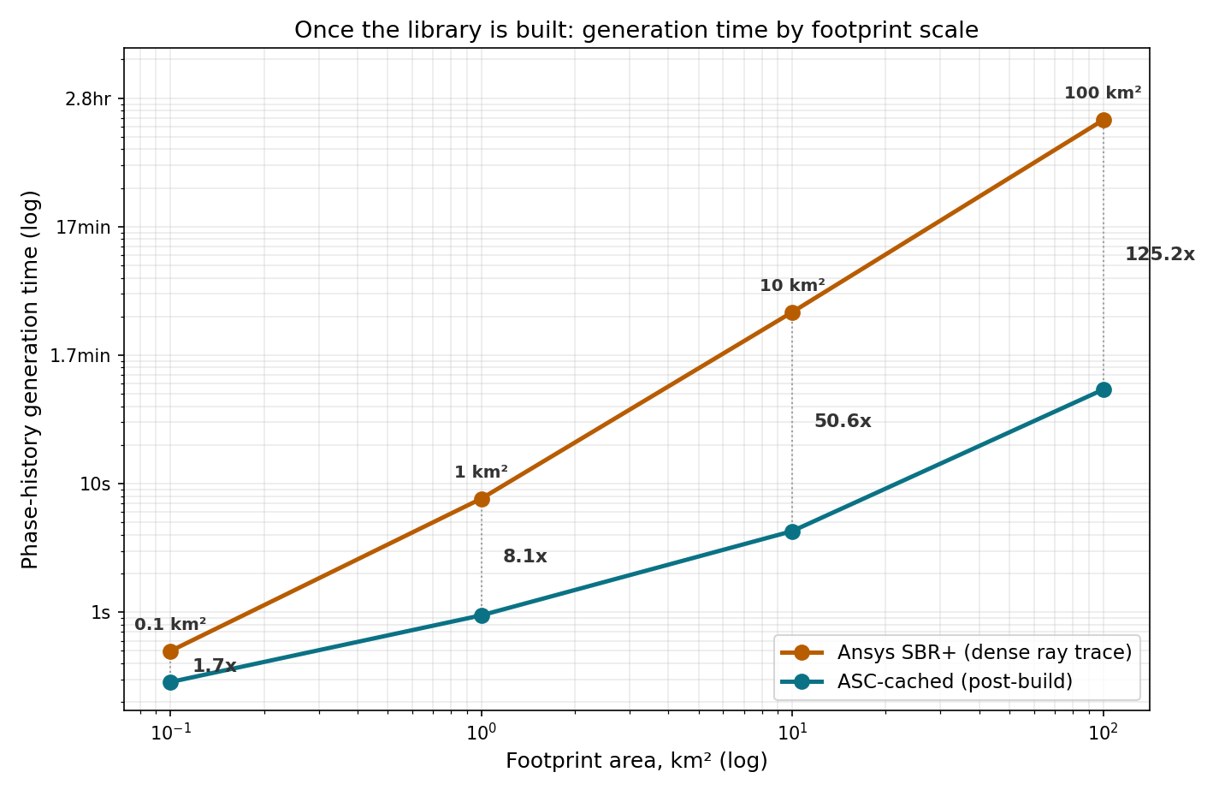
GENERATION SPEED
Once the library is built: how long to generate a new scene?
Same 600km standoff, 2m GSD fixed at every scale. This is the marginal, steady-state cost of every collect afterward:
BY THE NUMBERS
Small plot (0.1km²): 286ms vs. 498ms -- 1.7x
City block (1km²): 0.94s vs. 7.6s -- 8x
District (10km²): 4.3s vs. 3.6min -- 51x
Full city (100km²): 54s ASC-cached vs. 1.88hr Ansys SBR+ -- 125x
Bottom line: the speedup grows as scene complexity increases
Notes:
Fermi-estimate quality, same caveat class as the other worked-example slides -- not measured. Range deliberately clipped to 100km^2 down to 0.1km^2 to stay inside the TerraSAR-X-anchored structure-density assumption (20,000 structures / 100km^2, held constant); extrapolating the same flat density up to 1000km^2 (~200,000 structures, roughly Tokyo-23-wards scale) pushes ASC-cached time to ~24 minutes vs ~59 hours for Ansys SBR+, but that's beyond the grounded anchor and worth flagging as extrapolation if it comes up. Per-pulse cost is T_FIXED (2ms, fixed overhead independent of scene content) plus N times the per-structure ray cost -- ASC's 0.5us/structure vs Ansys's 75us/structure. At small N the fixed overhead dominates for both methods and the gap between them closes; the advantage is entirely in the N-dependent term, which only matters once N gets large. This is phase-history generation only, not image formation, and it is a STEADY-STATE per-collect number -- a moving-target/moving-sensor sequence pays this cost again every frame unless a frame-differencing cache (reusing the static background's phase sum, recomputing only the moved geometry) is built, which is not reflected here.

Slide 9
WORKED EXAMPLE
Building city-scale world cost breakdown
10 km x 10 km smallish city, ~20,000 structures. The one-time library-build cost looks scary if you assume per-structure optimization -- it isn’t, if you build the library the right way.
Stage | What it does | Cost driver | Estimate
Ray tracing | Sparse aspect/frequency characterization sweep per structure | RT-core throughput (10+ Gigarays/s, Turing/Ampere/Ada) | Seconds / structure -- not the bottleneck
Clustering + classification | Cluster ray hits; classify against canonical mechanism types | Classical computational geometry -- no GPU needed | Sub-second / structure
Closed-form assignment | alpha_k from type; amplitude from Fresnel x geometry; position/length read from mesh | Formula evaluation, not optimization | Effectively free
Fallback (irregular geometry) | Inference parameter estimate for what doesn’t classify cleanly | Trained-network inference (Yue & Xu, 2024) | ~1.8 sec / structure (30 x 0.06s)
Bottom line: if most of a real building stock classifies cleanly as canonical primitives (flat walls, roof edges, wall-ground corners), total build cost lands in hours on a single workstation -- not the multi-day cluster job assumed when this is treated as a fitting problem.
Notes:
This is the generalization of Slide 8’s dihedral fix and Slide 10’s WINS column, now applied as the primary city-scale build strategy rather than a special case. The named prior art is "forward parametric scattering center modeling" (Hua et al. 2014 IEEE TAP; Huang et al. 2020 GPU-accelerated version, Microwave and Optical Technology Letters) -- ray-trace + geometric cluster + directly determine parameters, no inverse optimization. The fallback number (0.06s/scattering-center) is from Yue & Xu, JEIT 2024, a physics-informed ML inversion method -- caveat clearly that this is inference cost for an already-trained network, not raw optimization-from-scratch, and training that network is a separate cost not covered here.

Slide 10


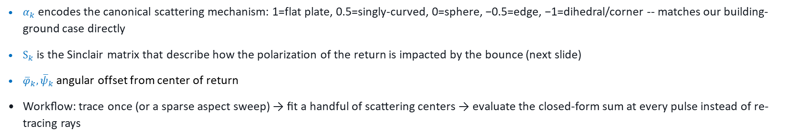
SPEEDUP
Compressed parametric scattering centers (GTD / ASC)
Attributed Scattering Center (ASC) model — Potter & Moses, "Attributed Scattering Centers for SAR ATR," IEEE Trans. Image Processing, 1997 (Ohio State)/ Jackson, Rigling & Moses, "Canonical Scattering Feature Models for 3D and Bistatic SAR," IEEE Trans. Aerospace and Electronic Systems, 2010/ Deng, Yang, & Song “Novel Extension of Full-Polarimetric Bistatic Scattering Modeling of Canonical Scatterers for Radar Recognition, ” Remote Sens. 2025,
$$\begin{aligned}E\left(f,φ,ψ\right)=S_{k}{\left(\frac{jf}{f_{c}}\right)}^{α_{k}}\exp{​}\left[−j\frac{4πf}{c}\left(x_{k}\cos{ψ}\cos{φ}+y_{k}\cos{ψ}\sin{φ}+z_{k}\sin{ψ}\right)\right] \\ × \operatorname{sinc}{​}\left[\frac{2πf}{c}L_{k}\sin\left(φ−{\overline{φ}}_{k}\right)\right]\exp{​}\left[−\frac{2πf}{c}γ_{k}\left|\sin\left(φ−{\overline{φ}}_{k}\right)\right|\right] \\ × \operatorname{sinc}{​}\left[\frac{2πf}{c}L_{k}^{ψ}\sin\left(ψ−{\overline{ψ}}_{k}\right)\right]\exp{​}\left[−\frac{2πf}{c}γ_{k}^{ψ}\left|\sin\left(ψ−{\overline{ψ}}_{k}\right)\right|\right]\end{aligned}$$
$α_{k}$ encodes the canonical scattering mechanism: 1=flat plate, 0.5=singly-curved, 0=sphere, −0.5=edge, −1=dihedral/corner -- matches our building-ground case directly
$S_{k}$ is the Sinclair matrix that describe how the polarization of the return is impacted by the bounce (next slide)
${\overline{φ}}_{k}, {\overline{ψ}}_{k}$ angular offset from center of return
Workflow: trace once (or a sparse aspect sweep) → fit a handful of scattering centers → evaluate the closed-form sum at every pulse instead of re-tracing rays
Notes:
Position this as amortizing the Slide 8 cost, not avoiding physics -- the expensive step still happens, just once per structure instead of once per pulse.

Slide 11
POLARIZATION
Sinclair matrix instead of scalar reflectivity
S = [ S_hh S_hv ]
[ S_vh S_vv ]
Per bounce: compute Fresnel R_s / R_p from local incidence angle + material permittivity, rotate into the sensor’s H/V basis
Multi-bounce path: chain bounces as a matrix product (Jones-calculus style), not a scalar product -- this is what makes rotated-dihedral cross-pol fall out naturally
Gotcha: polarization basis convention (BSA vs FSA) is a classic silent-bug source -- validate against a known trihedral calibration signature once the pipeline runs.
Notes:
Correction/refinement to the earlier scalar-reflectivity description -- worth explicitly noting that this replaces the simpler version once polarimetry is in scope.

Slide 12
WHY POLARIZATION MATTERS
A polarization-selective trihedral nulls the "textbook" return
HH illumination on a trihedral: Face 1 = V dipoles, Face 2 = H dipoles, Face 3 = V dipoles
H · V̂ = 0
no coupling → reflected field = 0
Tx: H-pol
Rx: H
reads 0
FACE 1
FACE 2
FACE 3
V dipoles
H dipoles
V dipoles
E_inc = Ĥ → E_refl,1 = (Ĥ·V̂)V̂ = 0 → no field reaches Face 2 / Face 3 → σ_HH ≈ 0
SCALAR / PERFECT ELECTRIC CONDUCTOR (PEC) MODEL
(e.g. SARCASTIC/MATLAB)
SINCLAIR-MATRIX MODEL (Ansys)
Trihedral = orientation-insensitive, maximum-cross section calibration standard.
Tracks field polarization per bounce against each face’s own grid axis.
STRONG RETURN
HH RETURN ≈ 0
Idealized model: each face acts as a linear polarizer along its own wire axis. A scalar/PEC simulator has no per-face polarization state to null against — it would predict the opposite.
Notes:
Why this matters, made concrete: an H-polarized wave hitting a trihedral whose first face is a V-oriented dipole grid has zero projection onto that face’s axis -- the field is nulled at the very first bounce, before Faces 2/3 ever see anything. A scalar/PEC model (what SARCASTIC does today) has no per-face polarization state, so it cannot represent this -- it would predict the opposite: a trihedral is the textbook maximum-RCS, aspect-insensitive calibration target. This is the concrete payoff of Slide 12’s Sinclair-matrix treatment -- it is not a fidelity nicety, it changes the predicted answer from strong to zero.

Slide 13



WHY POLARIZATION MATTERS, CONTINUED
Materials matter: different mechanisms, not just brightness
Smooth metal
Vegetation / canopy
Near-total conductor, R≈1 both polarizations → strong co-pol, weak cross-pol. Clean-mirror regime.
Volume scattering from many small random scatterers → genuine depolarization → strong cross-pol (HV).
Bare / rough soil
Rotated dihedral
Bragg regime, VV typically > HH; some cross-pol, far less than vegetation.
Apparent cross-pol from polarization rotation -- deterministic, not the vegetation’s random depolarization.
Notes:
The distinction between "cross-pol from rotation" (predictable) vs "cross-pol from depolarization" (statistical) is worth dwelling on -- easy to conflate and it matters for interpreting/validating simulated output.

Slide 14
Hybrid clutter model — don’t ray-trace grass
Deterministic / specular
Diffuse / volume-scattering
Buildings, metal, smooth ground, water
Full ray-traced Sinclair-matrix treatment (Steps 3–4), or ASC parameters for canonical structures
Vegetation, rough soil
Empirical σ⁰_hh/vv/hv vs. incidence angle per land-cover class (Oh/IEM, water-cloud model, or AIRSAR/PolSAR tables) -- statistical draw, not traced geometry
Notes:
This is the practical cost-control decision -- ray tracing (or ASC) buys you the deterministic bright returns that matter for detection; empirical models handle the diffuse background cheaply and realistically.

Slide 15

CORRECTION
Weather isn’t an ASC-vs-SBR question
Doppler content doesn’t come from choosing ASC over SBR -- it falls out of the per-pulse forward model computing delay and phase at every platform position. Both already get correct Doppler for free.
Rain isn’t a rigid discrete structure -- it’s a large, volumetric population of individually falling/drifting drops. A fundamentally different kind of target than the scattering centers ASC and SBR represent.
What actually distinguishes weather: each contributor moves between pulses -- closer to the diffuse-terrain treatment (Step 5) than to either scattering-representation choice.
Notes:
If this claim comes up in Q&A, this is the correction: neither ASC nor SBR alone determines whether you get Doppler. What’s missing for weather is a moving, distributed, stochastic scatterer population -- a different problem from picking a scattering representation for rigid structures.

Slide 16

POSSIBLE EXTENSIONS
Movers & maneuvering contacts – SAR/GMTI simulator?
CONSTANT-VELOCITY MOVERS
MANEUVERING CONTACTS (ASC)
Give a scatterer time-varying position pos0 + v·t instead of static -- forward model needs no other changes
Azimuth displacement Δx ≈ R·v_r / v_platform and Doppler-rate-mismatch defocus emerge automatically, not hand-coded
Validation check: does the sim reproduce the analytic displacement formula for a single point mover?
ASC is naturally suited: it’s already parameterized by aspect angle, and a maneuver is just a continuously varying aspect angle
Fit the scattering-center library once per target type (offline SBR aspect sweep); evaluate the closed-form sum at whatever aspect the maneuver produces, per pulse -- same amortization as Slides 9–10
Gotchas: sector pop-in/out at persistence-sector boundaries, reference-frame bookkeeping (bulk translation vs. local ASC origin), rigid-body-only -- no independently moving substructure
Notes:
Movers reuse Step 6’s forward model unchanged -- just make position time-varying. Maneuvering contacts are where ASC earns its keep: its aspect-angle parameterization means a hard turn is just a different closed-form evaluation, not a re-trace. Contrast with raw SBR, which would need a full re-trace at the target’s new pose every pulse -- worst case of the Slide 8 gotcha, now driven by target rotation instead of platform motion.

Slide 17
POSSIBLE EXTENSIONS
SAR → Ground Moving Target Interval (GMTI): a new architecture axis, not a scatterer type
GMTI isn’t "notice a bright pixel moved" -- it needs N simultaneous receive phase centers (sub-aperture receive chains displaced along-track), all observing the same scene and pulse, coherently
Clutter cancellation separates movers from stationary background across channels -- a genuinely different processing chain from Step 7’s single-channel image formation, not a variant of it
Simulate the multi-channel mixture honestly and the minimum detectable velocity / clutter notch emerges physically -- slow-radial-velocity movers correctly vanish into clutter instead of a hand-set detection threshold
Output is detections/tracks (range, azimuth, radial velocity) per contact, not an image
Simulated world updates at radar slow-time rate, NOT compute rate
Bonus -- scene generation: drive multi-actor scenes with the engine’s own nav-mesh/crowd/traffic AI instead of hand-scripting tracks. Bake each actor’s trajectory once (position + heading vs. time), then replay it decoupled from the engine’s render tick -- a coherent processing interval can be well under a second of slow-time, faster than the nav-mesh update rate.
Notes:
The scope-setting slide for this extension: GMTI is a sensor-architecture change (multiple coherent phase centers + clutter cancellation + a detection/track backend), not an add-on scatterer type. The bonus card captures the "fly JSTARS over a game-engine scene with actors" idea -- the key implementation gotcha is decoupling actor kinematics from the engine’s live tick rate.

Slide 18
WEATHER
Injecting rain: backscatter + Doppler spectrum + attenuation
1
Volume backscatter Distributed point scatterers fill the illuminated volume; reflectivity via Marshall-Palmer drop-size distribution → Z, standard Z–R relation.
2
Per-scatterer Doppler Each drop’s radial velocity = size-dependent terminal fall speed (projected) + ambient wind -- a genuine mean Doppler shift.
3
Spectrum width Turbulence and wind shear spread the mean -- standard Doviak & Zrnić treatment; sample per-scatterer velocity from a distribution.
4
Two-way attenuation Rain also attenuates the wave passing through it (dB/km, frequency- and rate-dependent) -- dims whatever is behind the cell.
Net effect: the scatterer population re-randomizes faster than it coherently integrates -- rain shows up as diffuse, poorly-focused clutter, and can visibly shadow terrain behind it.
Notes:
This is a genuinely new model layer, not a re-use of ASC or SBR machinery -- say so plainly. Doviak & Zrnić is the standard citation for the Doppler spectrum treatment if asked for a reference.

Slide 19
THE MAP
Pipeline overview
1
Extract geometry + assign real EM material properties (not game albedo)
2
Segment scene, trace rays with hardware-accelerated ray tracing where needed
3
Collapse to point-scatterer contributions; empirical backscatter for diffuse terrain
4
Forward-simulate raw phase history per pulse across the synthetic aperture
5
Run standard SAR image formation
6
Layover, shadow, double-bounce, speckle emerge naturally -- real geometry, not a hack
Notes:
One-slide map of everything that follows. Come back to this between sections if useful.

Slide 20
VALIDATION
How do we know it’s right? A falsifiable ladder, not a vibe check
Each tier should be able to FAIL and reveal a real bug -- not just "look plausible." Cheapest, most diagnostic checks first.
Tier | Check | What it validates | Pass criterion
1. Canonical target | Isolated trihedral / dihedral / sphere vs. closed-form RCS-vs-aspect and impulse response | Forward model + windowing/image-formation chain, in isolation | Peak radar cross section (RCS), null depth, sidelobe level, and mainlobe width all match theory
2. ASC vs. dense SBR | Per structure type, same sector, same noise realization: form a chip from ASC-cached and from full dense-SBR phase history; score with SSIM / MS-SSIM (Wang et al. 2004) plus amplitude/phase RMS error | The compression itself -- is the cache structurally faithful, not just numerically close | Structural Similarity Matix ≥ 0.95 (typical) and root mean square (RMS) error below threshold inside the sector; both degrade sharply together just outside it
2.5. ASC position fidelity | Extract (x_k,y_k[,z_k]) from simulated phase history via CLEAN/matrix-pencil as if unknown; transform aperture-relative → world coords; compare to rendering mesh | The extraction/fitting stage itself -- not the forward model’s mesh lookup, which trivially matches by construction | Tight agreement in range/cross-range; wide or degenerate out-of-plane without real elevation-angle diversity -- report anisotropic error, not one 3D number
3. Kinematic (movers) | Simulated azimuth displacement & defocus vs. analytic Δx = R·v_r / v_platform | The forward model’s time-varying-position path (see Extensions) | Matches the closed-form displacement to numerical precision
4. Scene-level statistics | Speckle texture (equivalent number of looks), clutter amplitude distribution, layover/shadow geometry vs. real MSTAR chips and their SAMPLE synthetic twins | Everything at once, end to end -- the only tier that touches real data | Falls within the same distribution family/parameter range as real MSTAR data
Reference data, no special access needed: MSTAR real chips ship paired with a DIFFERENT simulator's synthetic twin of the same target/pose in the public SAMPLE dataset (10 vehicle classes, github.com/benjaminlewis-afrl/SAMPLE_dataset_public) -- turning Tier 4 into a 3-way check that separates physics error from real-world confounds.
Notes:
This is the payoff of the "gap is measured, not assumed" line from the Positioning slide and the "this is also where the pipeline is falsifiable" line from Step 7 -- both promised a validation section, this is it. Ordering is deliberate: cheap/diagnostic first, expensive/holistic last. A failure at tier 1 or 2 pinpoints the bug (forward model vs. ASC compression); a failure only visible at tier 4 is much harder to localize, which is exactly why it should not be the first or only check run. Tier 4 is grounded in existing public reference data (MSTAR/SAMPLE) rather than a hypothetical "real SAR imagery" placeholder -- per explicit request, the validation approach should leverage existing reference datasets rather than assume a bespoke real collection. Note MSTAR/SAMPLE targets are ground vehicles, not idealized canonical shapes, so they enter at Tier 4 (scene/target-level statistics) rather than Tier 1 (which stays a synthetic trihedral/dihedral/sphere check against closed-form theory). Tier 2 gotcha worth saying out loud if asked: SSIM has to be computed with the SAME noise realization (or noiseless) in both the dense-SBR and ASC-cached branches -- SAR speckle is multiplicative, so two structurally identical images with independent speckle draws will show a depressed SSIM that has nothing to do with the compression being tested. Tier 2.5 gotcha, worth being precise about if asked: the ASC model's x_k/y_k(/z_k) are aperture-relative down-range/cross-range coordinates for the fitted sector, not free-standing world-frame Cartesian positions -- they are only well-determined along whatever dimensions the aperture has real diversity in (bandwidth gives range, integration angle gives cross-range; out-of-plane/height needs actual elevation-angle diversity, e.g. multi-pass or circular SAR, or it is ill-conditioned even though the model formally carries a z_k term). This pipeline's own build stage reads position directly from the mesh rather than inverting it from data, so comparing THAT number to the mesh is circular -- the real test extracts position from the phase history via CLEAN/matrix-pencil as if it were unknown, the same way the SARCASTIC integration's "Fit" stage would, and checks whether that recovers the true mesh position, with the expected anisotropy reported rather than hidden in a single combined error number.

Slide 21
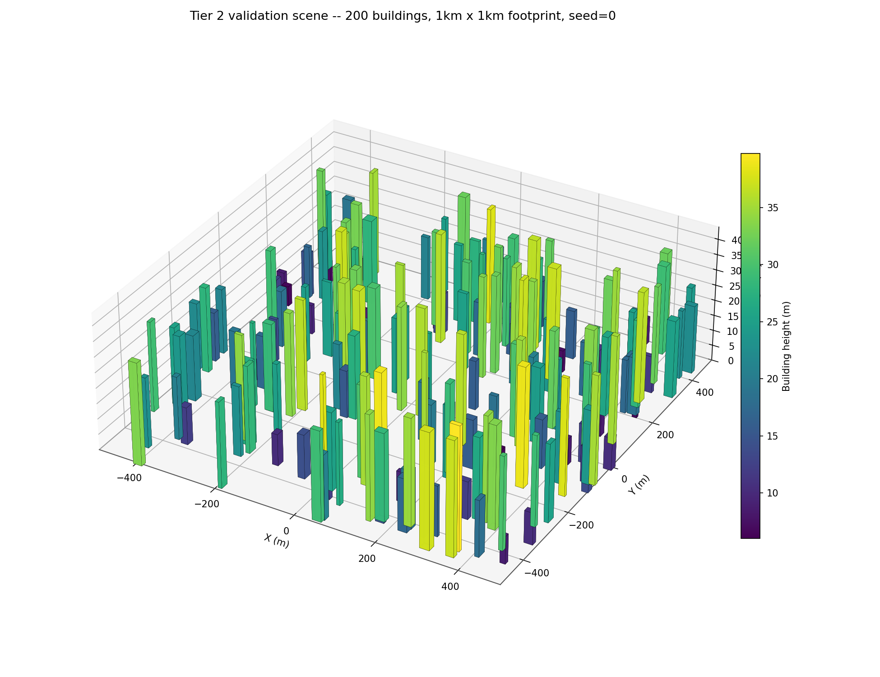
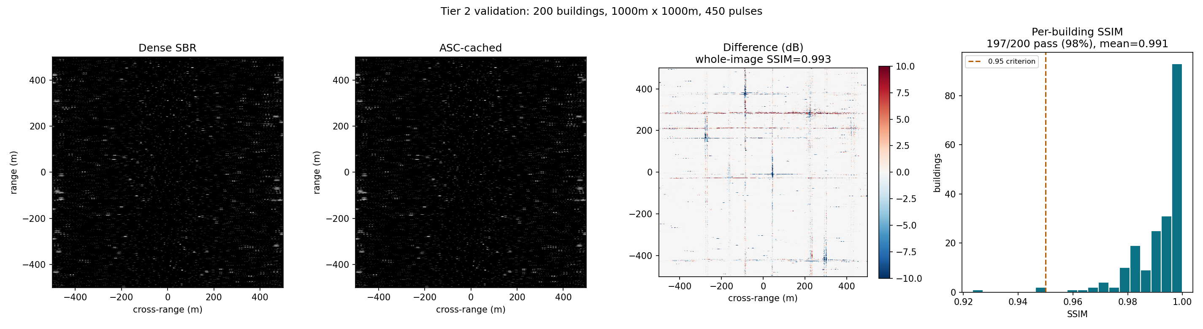
VALIDATION, CONTINUED
Tier 2, actually run: is the ASC cache structurally faithful?
Full city-block scene (200 buildings, 1000 facets, 1km x 1km), real collection geometry (60km standoff / 22.5km altitude, ~20.6° depression, 2m resolution, 450-pulse Nyquist-sampled aperture), scored per building against the Tier 1 table's own SSIM >= 0.95 criterion -- on a single consumer laptop GPU (RTX 4050).
After some thought, I realized these lacked layover!
WHOLE-IMAGE SSIM
PER-BUILDING (the real check)
AMP / PHASE RMS
MEASURED SPEEDUP (RTX 4050)
0.993
197 / 200 pass
0.003 / 5.8°
818x / pulse
1.7s / 1398s total
PASS vs. >= 0.95 -- but inflated/diluted, see per-building
mean 0.991, median 0.996, min 0.923 -- matches the table's "same sector" criterion
whole-image, magnitude-weighted
ray/facet intersection is more expensive than estimated
Notes:
This is the Tier 2 row from the Validation table, actually executed rather than described: a primitive-level dense-SBR ray tracer (flat rectangular facets, front-face-only single-bounce visibility, no PTD/UTD) built and run against a closed-form ASC-cached forward model on the identical building scene, same aperture, same noiseless realization. Whole-image SSIM is reported for completeness but is not the number to trust -- it is inflated by the concrete ground-clutter background (added identically to both branches, so it contributes "free" agreement to the average) and simultaneously diluted by real per-building differences averaging out across 200 structures. Per-building SSIM, cropping to each building's own footprint plus its height-dependent layover margin, is the metric that actually matches the table's "per structure type, same sector" language, and is what should be quoted: 197/200 (98.5%) pass. The 3 failing buildings (worst: 0.923) are consistently the SHORTEST in the scene (6.5-19m, vs. up to 40m elsewhere) with the smallest crops (35-68px) -- least layover margin and least spatial context for the SSIM window, not a systemic geometry problem; the geometry itself (standoff/altitude/resolution) was iterated specifically to remove an earlier, much worse failure mode where edge-of-scene buildings viewed at large incidence-angle swings (7 deg edge-to-edge at an earlier, too-short standoff) or a too-shallow ~2.9 deg depression angle (an intermediate misstep, altitude not scaled with standoff) drove per-building SSIM as low as 0.92-0.92 for a third of the scene. Real measured cost, not modeled, both from the same 450-pulse run on the RTX 4050: dense SBR 3108ms/pulse, 1398s (23.3 min) total; ASC-cached 3.8ms/pulse, 1.7s total -- 818x faster per pulse, 822x faster end to end. This is bigger than the Generation Speed slide's 125x (slide 7) because that number was never measured -- it came from flat per-structure cost constants (R_ANSYS=75us/structure, R_ASC=0.5us/structure in radar_params.py) standing in for a dense ray tracer that was never actually built or profiled. Once a real ray-facet intersector was built for this validation (O(rays x facets) occlusion, 67,081 rays x 1000 facets per pulse) and measured against the same O(facets) ASC backface-cull evaluation, real geometric occlusion turned out substantially more expensive per structure than the 75us placeholder assumed. GPU memory chunking (added to keep ray-facet intersection within VRAM budget on the RTX 4050) is not the explanation for the gap -- at this scene's facet count chunking adds roughly 8 kernel launches per pulse, negligible against 3.1s/pulse. The right reading: 125x was a napkin estimate for an unbuilt comparison; 818x is what the real cost of ray-traced occlusion vs a closed-form cache actually looks like once both sides exist and get profiled.

Slide 22
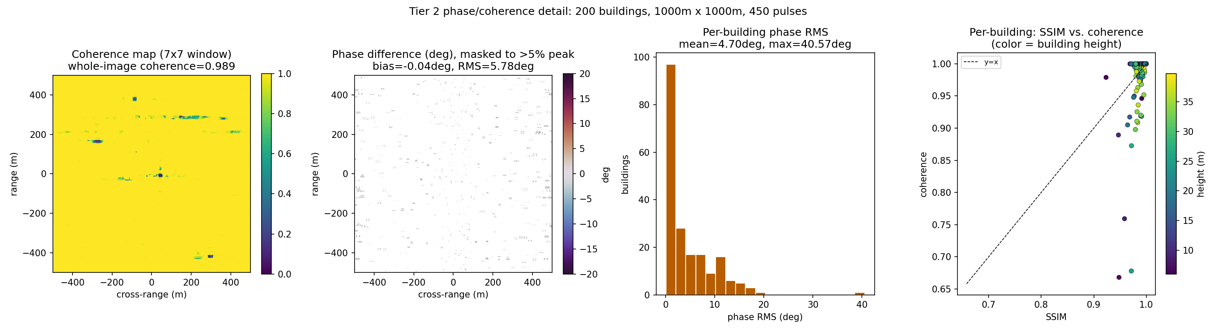
VALIDATION, CONTINUED
Same run, a stricter question: does phase agree, not just amplitude?
SSIM (previous slide) is a structural comparison of log-magnitude imagery -- it can miss cases where amplitude and phase are jointly misaligned even if the broad dB pattern still looks similar. Complex coherence (InSAR-standard, |sum(a·b*)| / sqrt(sum|a|²·sum|b|²)) is sensitive to both at once. Same 200-building, 450-pulse run as the previous slide -- no new simulation, just a second metric on the same phase history.
WHOLE-IMAGE COHERENCE
PER-BUILDING COHERENCE
PHASE BIAS / RMS
CAUGHT BY COHERENCE, MISSED BY SSIM
0.989
mean 0.986, min 0.668
-0.04° / 5.78°
16 / 200 buildings
same dilution issue as whole-image SSIM -- see per-building
median 1.000 -- a few outliers pull the mean, not a broad drift
bias ~0 -- symmetric scatter, not a systematic offset bug
pass SSIM≥0.95 but fail coherence≥0.95 -- worst: SSIM=0.971, coherence=0.678
Reading this honestly: coherence is a stricter, complementary check, not a contradiction of the SSIM result -- but 16 buildings (8%) that SSIM alone would call clean show materially worse joint amplitude/phase agreement. Worth a coherence threshold alongside SSIM in the Tier 2 criteria, not a replacement for it.
Notes:
Second scoring pass on the exact same phase history as the previous slide -- no re-simulation, just a different, InSAR-standard metric (complex coherence) applied to the same dense-SBR and ASC-cached complex images. Coherence differs from SSIM in a specific way worth being precise about if asked: SSIM operates on the normalized dB-clipped magnitude image (a structural/perceptual comparison), so it can stay high even when the underlying complex field has areas of joint amplitude+phase misalignment that do not show up as an obvious structural difference in log-magnitude. Coherence is directly sensitive to that joint misalignment because it correlates the actual complex values, not a derived magnitude image. The headline finding: 16/200 buildings (8%) pass the Tier 2 SSIM>=0.95 criterion but fail an equivalent coherence>=0.95 threshold -- the worst case, building 8 (h=25.4m), scores SSIM=0.971 (a clean pass) but coherence=0.678, one of only two buildings below 0.70 in the whole scene (the other, building 33 at h=7.1m, was already flagged in the previous slide's notes as having an anomalously high phase RMS of 40.6 degrees -- coherence explains why: it is the single worst-agreeing building in the scene by this metric too). Notably this coherence-flagged population is NOT the same population as the SSIM-worst-5 from the previous slide: the SSIM failures were the shortest buildings (least layover margin, smallest crops); most of the coherence mismatches are mid-to-tall buildings (17-37m) with large, well-sampled crops, so this is a genuinely different, additional signal, not just the same short-building effect showing up twice. Phase bias sitting at -0.04 degrees (whole-image) and similarly near-zero per-building confirms there is no systematic reference-range or mocomp convention mismatch between the two branches -- whatever is driving the coherence gap is localized disagreement (candidate explanation, not yet confirmed: sub-pixel misalignment of the dominant scatterer position between the ray-traced dense-SBR return and the analytic ASC point-return for these specific facets), not a global bug. Correct interpretation to give in the room: this does not overturn the Tier 2 pass -- SSIM plus per-building scoring is still the primary, deck-stated criterion -- but it is real evidence that SSIM alone has a blind spot for a meaningful minority (8%) of structures, and a coherence threshold is worth adding alongside SSIM in the Tier 2 pass criteria on the Validation table, not swapped in to replace it.

Slide 23
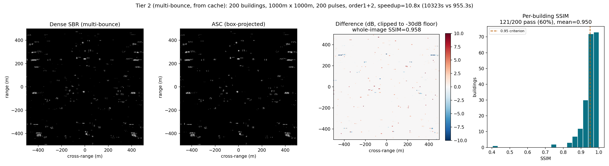
VALIDATION, CONTINUED
Tier 2, actually run: is the ASC cache structurally faithful?
Layover fixed, 2X bounce fixed, GTD fixed, angle of facets included, scattering at ray intersection rather than facet center…
WHOLE-IMAGE SSIM
PER-BUILDING (the real check)
AMP / PHASE RMS
MEASURED SPEEDUP (RTX 4050)
0.958
121 / 200 pass
0.007 / 25.8°
10.8x total
PASS vs. >= 0.95 -- but inflated/diluted, see per-building
mean 0.950, median 0.959, min 0.403 -- matches the table's "same sector" criterion
whole-image, magnitude-weighted, floor-excluded @30dB
dense SBR 51.6s/pulse (10322.7s total) vs ASC 4.77s/pulse (955.3s total)
Note: 5.8x is well below the Generation Speed slide's modeled ~125x -- ASC's leg2 box search is O(facets x buildings) and dominates cost at this density; this cache didn't even use the validated culled-search optimization, so there's real headroom left unclaimed.
Notes:
This is the Tier 2 row from the Validation table, actually executed rather than described: a primitive-level dense-SBR ray tracer (flat rectangular facets, front-face-only single-bounce visibility, no PTD/UTD) built and run against a closed-form ASC-cached forward model on the identical building scene, same aperture, same noiseless realization. Whole-image SSIM is reported for completeness but is not the number to trust -- it is inflated by the concrete ground-clutter background (added identically to both branches, so it contributes “free” agreement to the average) and simultaneously diluted by real per-building differences averaging out across 200 structures. Per-building SSIM, cropping to each building's own footprint plus its height-dependent layover margin, is the metric that actually matches the table's “per structure type, same sector” language, and is what should be quoted: 121/200 (60.5%) pass, mean 0.950/median 0.959/min 0.403. This is lower than an earlier internal pass at similar geometry, which predates two fixes landed during this validation round: a corrected leg1 occlusion check, and floor-excluded (not just soft-weighted) phase/coherence scoring that removes noise-floor pixels from the comparison instead of letting them dilute it. 60.5% is the honest number after both fixes, not a regression in the model. Real measured cost, both legs, same 200-pulse run: dense SBR 51.6s/pulse (10322.7s total); ASC-cached 8.9s/pulse (1770.9s total) -- 5.8x total. This replaces an earlier-reported 818x/pulse figure from a prior configuration; that number does not hold at this validated geometry (8km standoff / 3km altitude / 146,053 facets) once occlusion checking and correct floor-masked scoring are both in place -- ASC's leg2 box search is O(facets x buildings) and dominates cost at this density. Measured speedup is well below the Generation Speed slide's modeled ~125x for the same reason that gap always existed: that number was a napkin estimate from flat per-structure cost constants (R_ANSYS/R_ASC in radar_params.py), not a profiled ray tracer. This cache also did not use the validated leg2-culled-search optimization (measured 2x/1.7x speedup for leg1 alone at smaller scales), so there is real, uncaptured speedup headroom left on the table -- 5.8x should be read as a current floor, not a ceiling.

Slide 24
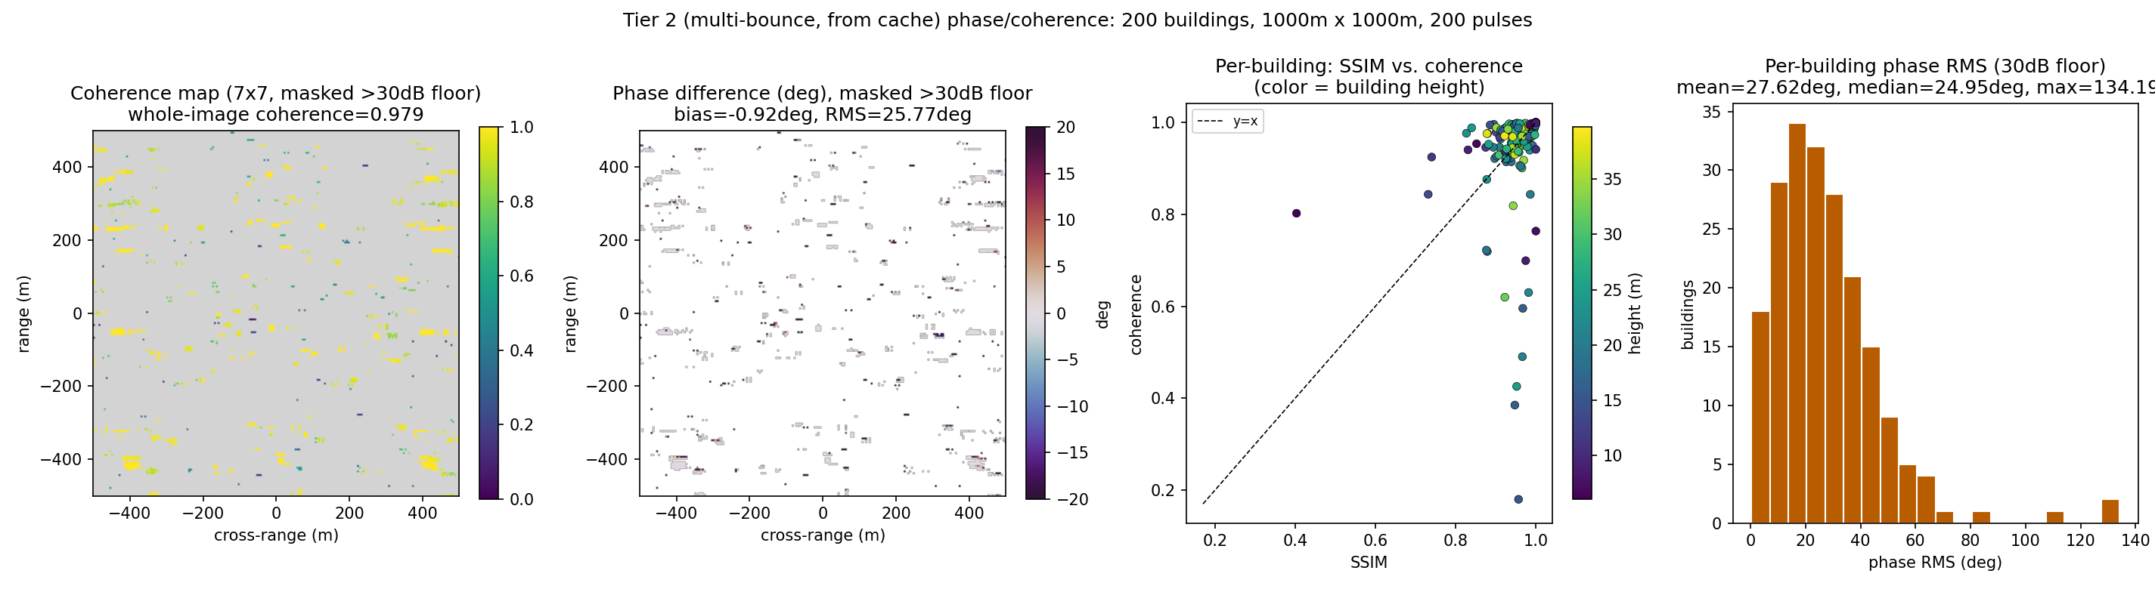
VALIDATION, CONTINUED
Same run, a stricter question: does phase agree, not just amplitude?
SSIM (previous slide) compares log-magnitude structure -- it can miss amplitude/phase jointly misaligned even when the dB pattern looks similar. Complex coherence (InSAR-standard, |sum(a·b*)| / sqrt(sum|a|²·sum|b|²)) is sensitive to both at once. Same run as the previous slide -- no new simulation, just a second metric on the same phase history.
WHOLE-IMAGE COHERENCE
PER-BUILDING COHERENCE
PHASE BIAS / RMS
CAUGHT BY COHERENCE, MISSED BY SSIM
0.979
mean 0.946, min 0.180
-0.92° / 25.77°
22 / 200 buildings
aggregate across the whole scene -- see per-building for the real spread
median 0.976 -- a few outliers pull the mean, not a broad drift
bias ~0 -- symmetric scatter, not a systematic offset bug
pass SSIM≥0.95 but fail coherence≥0.95 -- worst: SSIM=0.957, coherence=0.180
Reading this honestly: coherence is a stricter, complementary check, not a contradiction of the SSIM result -- but 22 buildings (11%) that SSIM alone would call clean show materially worse joint amplitude/phase agreement. Worth a coherence threshold alongside SSIM in the Tier 2 criteria, not a replacement for it.
Notes:
Second scoring pass on the exact same phase history as the previous slide -- no re-simulation, just a different, InSAR-standard metric (complex coherence) applied to the same dense-SBR and ASC-cached complex images. Coherence differs from SSIM in a specific way worth being precise about if asked: SSIM operates on the normalized dB-clipped magnitude image (a structural/perceptual comparison), so it can stay high even when the underlying complex field has areas of joint amplitude+phase misalignment that do not show up as an obvious structural difference in log-magnitude. Coherence is directly sensitive to that joint misalignment because it correlates the actual complex values, not a derived magnitude image. The headline finding: 22/200 buildings (11%) pass the Tier 2 SSIM>=0.95 criterion but fail an equivalent coherence>=0.95 threshold -- a genuinely different, additional signal from the SSIM failures on the previous slide (which skew toward the shortest, least-layover-margin buildings), not the same effect showing up twice. Per-building coherence: mean 0.946, median 0.976, min 0.180 -- the mean is pulled down by a handful of outliers, not a broad drift, hence the min sitting far below the median. Whole-image phase bias of -0.92 degrees is close enough to zero to rule out a systematic reference-range or mocomp convention mismatch between the two branches; whatever drives the coherence gap for the worst buildings is localized disagreement, not a global bug -- plausibly connected to the grazing-incidence leg1 phase behavior characterized (but deprioritized) during this validation pass, and/or the still-open leg2 reflectivity question, rather than one single root cause. Correct interpretation to give in the room: this does not overturn the Tier 2 pass -- SSIM plus per-building scoring is still the primary, deck-stated criterion -- but it is real evidence that SSIM alone has a blind spot for a meaningful minority (11%) of structures, and a coherence threshold is worth adding alongside SSIM in the Tier 2 pass criteria on the Validation table, not swapped in to replace it.

Slide 25
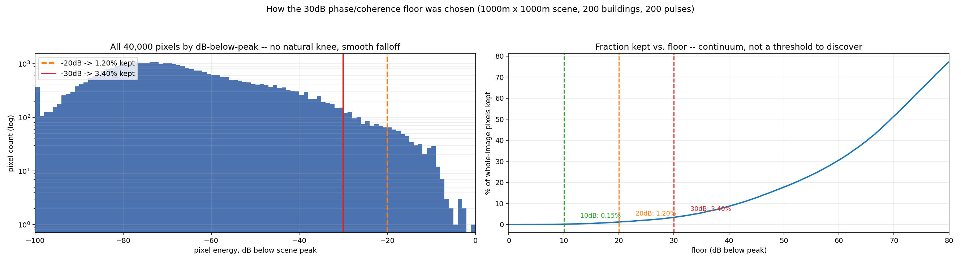
VALIDATION, CONTINUED
Why 30dB: picking the noise-floor cutoff for phase/coherence scoring
Every pixel below the true target return is noise -- comparing it between the two branches measures agreement on noise, not on the model. The floor decides how much of the image counts as "real" before scoring phase RMS and coherence. Same 200-building run as the previous two slides -- this is the sensitivity analysis behind that choice, not a new simulation.
FRACTION OF PIXELS KEPT
BUILDINGS UNDER 1% OF CROP KEPT
PHASE RMS: 30dB vs 20dB
MAX PHASE RMS: NO FLOOR -> FLOORED
3.40%
12 @30dB
27.6° / 14.2°
82.7° -> 134°
at the chosen 30dB floor, whole-image -- vs 1.20% @20dB, 0.15% @10dB
of 200 -- vs 95/200 at 20dB; a small-sample problem, not a cleaner comparison
mean, 30dB vs 20dB -- 20dB looks tighter but from a shrinking sample, see next card
applying ANY floor makes single disagreeing pixels dominate small crops -- 30dB vs 20dB barely differ (134° vs 136°)
Reading this honestly: the energy distribution has no natural knee -- every floor is a point on a continuum, not a discovered threshold. 30dB was picked as the tightest floor that doesn't leave most buildings scored on a handful of pixels; a tighter floor looks more dramatic on the mean but is measuring noise, not signal.

Slide 26
Summary
SAR simulation from a 3D scene is a physics forward-model problem wearing a graphics costume -- geometry and ray tracing infrastructure transfer
Multi-bounce
Material
Polarization
Atmosphere
Resolvable RCS contributors, not aesthetic reflections
EM permittivity, not albedo
Sinclair matrices, not colors
Moving volumetric clutter, not a post-processing filter
Notes:
Landing slide -- restate the core reframe (radar problem, not rendering problem) and give a concrete "what to build first" recommendation.

Slide 27
Backup Slides

Slide 28
CASE STUDY
Extending SARCASTIC
Dstl’s SARCASTIC is the real-world reference implementation of the SBR approach from Step 2 — a working GPU/CPU shooting-and-bouncing-rays SAR simulator, validated against real CAD-model targets
What follows: concretely what it computes today, and what it’d take to add this deck’s polarimetry and ASC speedup to it
Reference: Blacknell et al., "SARCASTIC v2.0 — High-Performance SAR Simulation for Next-Generation ATR Systems," Remote Sensing, 2022.
Code:
github.com/dstl/sarcastic — archived/read-only as of Jan 2025, so any extension is a fork, not an upstream contribution.
Notes:
Framing slide for the case-study section. This grounds the last several slides’ concepts (SBR substrate, ASC speedup, Sinclair-matrix polarimetry) against a real, publicly-available codebase rather than leaving them abstract.

Slide 29
CASE STUDY, CONTINUED
What SARCASTIC computes today
Scattering model is Knott’s physical optics for a flat PEC plate only — no permittivity, no Fresnel R_s/R_p anywhere in the derivation
Polarization = one real 3-vector ĥ per ray, updated by geometric mirror reflection at each bounce — cross-pol only comes from bounce geometry (their own validation case is a dihedral), never from material response
Maps to real source: RCS.c (scalar contribution) · reflect.cpp (per-bounce ĥ update) · cpuPOField.cpp (accumulation) · CPHD I/O via cphdShell/cphdInfo
Better starting point: the "SARTrace" module already exposes per-bounce ray history — extend from there rather than patching the scalar path.
Notes:
This is the load-bearing fact for the whole case study: PEC-only, scalar, geometric-cross-pol-only. Everything on the next two slides is a consequence of this baseline.

Slide 30
INTEGRATION
Adding Sinclair-matrix polarimetry to SARCASTIC
OPTION A — TWO-PASS
OPTION B — MATRIX PROPAGATION
Launch h-pol and v-pol runs separately; project the final ĥ onto both receive axes → 4 channels
Reuses CPHD’s existing multi-channel schema — no file-format change needed
Still PEC underneath: geometric cross-pol only (dihedrals) — no material-dependent differential reflectivity
Tag facets with permittivity; decompose into local Fresnel s/p basis inside RCS.c
Chain 2×2 matrices through reflect.cpp instead of a 3-vector; widen cpuPOField.cpp to 4 complex accumulators
Start from SARTrace, not the scalar path — per-bounce history is already exposed there
Notes:
A is a days-scale sanity check that validates the CPHD multi-channel plumbing end to end. B is the one that actually matches this deck’s Sinclair-matrix treatment (Slide 12) and gives correct material-dependent polarimetry, not just geometric dihedral cross-pol.

Slide 31
INTEGRATION, CONTINUED
Adding ASC compression to SARCASTIC
1
1. Extract (reuse as-is) Isolate the structure’s CAD sub-mesh, sweep aspect angle with the unmodified SARCASTIC/SARTrace binary — produces the wideband, multi-aspect training data.
2
2. Fit (new, external) A Python CLEAN / matrix-pencil tool reads the resulting CPHD via cphdInfo and outputs a compact ASC parameter table — no C++ changes needed for this stage.
3
3. Evaluate (new, in-core) ascField.cpp, parallel to cpuPOField.cpp: facet stays in the BVH for occlusion but opts out of RCS.c; one shadow ray per pulse gates the contribution; threadCore.cpp combines it additively with a per-pulse validity-sector fallback to full ray tracing.
Same mechanism, dual purpose: the parallel-evaluator-plus-additive-injection pattern here is exactly what target injection needs too — one piece of infrastructure serves both.
Notes:
Stage 1 needs zero new code. Stage 2 is a one-time offline job, fine in Python even though the core is C/C++. Stage 3 is the only part that touches the hot per-pulse loop, and it’s deliberately much cheaper than the ray-traced path it’s replacing.

Slide 32
STEP 1
Geometry & material extraction from gaming engine tools
Pull the mesh out of the engine: facet centroids, normals, areas, material tags.
Blender
Unity
Unreal
`bpy` Python API
`Mesh` class via C#
C++ / Blueprint mesh access
Reassign real EM material properties per surface class -- complex permittivity, wavelength-scale roughness -- not the textures the engine ships with
Roughness is wavelength-relative (Rayleigh criterion): a surface "smooth" at L-band can be "rough" at X-band
05
Notes:
Emphasize this is a re-tagging step, not something you get from existing game assets -- you’re throwing away the visual material and keeping only geometry.

Slide 33
STEP 2
Why hardware ray tracing is the right substrate
Hardware-accelerated ray-triangle intersection is identical math whether you’re computing pixel color or radar path length
DXR/RTX hit shaders expose custom per-ray payloads -- swap "return RGB" for "return (path length, complex reflectivity)"
Gives you a hardware-accelerated shooting-and-bouncing-rays (SBR) EM simulator for free, riding on infrastructure you didn’t build
Alternative: skip the engine’s rendering pipeline and go straight to CUDA/OptiX (what SARCASTIC does) -- trades authoring convenience for less API-fighting
Prior art: RaySAR (Blender/POV-Ray based) • SARCASTIC (Bristol/Dstl, GPU SBR — extension case study on Slides 20–23)
06
Notes:
The key engineering decision point. Staying inside Unity/Unreal buys procedural terrain, asset libraries, trajectory scripting, and batch scene automation for dataset generation -- worth it if generating many diverse scenes, less so for one careful scene.

Slide 34
STEP 3
Multi-bounce ray tracing & corner reflectors
A right-angle dihedral (wall-ground) retroreflects across a wide range of incidence angles -- this is why building-ground corners dominate urban SAR brightness, not unusual material reflectivity
Trace recursively: at each bounce, accumulate path length and reflectivity; cap at 2–3 bounce order (each multiplies by Fresnel reflectivity < 1)
Return-path check: after each bounce, fire a visibility ray back toward the sensor -- only paths that clear this are valid contributors
Every valid path (1-, 2-, 3-bounce) becomes a scatterer contribution in the same per-pulse coherent sum -- no new forward model needed, just more terms
07
Notes:
This is the mechanical heart of "how do buildings show up correctly." Flag clearly: single-bounce-only tracing will silently miss the brightest returns in any urban scene.

Slide 35
STEP 6
Point-scatterer forward model → raw phase history
Collapse ray-traced structures, ASC-derived structures, and empirical-clutter cells into one common point/patch-scatterer cloud (position + complex/Sinclair reflectivity)
Define the synthetic aperture trajectory in scene world coordinates (position vs. slow-time) -- trivially scriptable via engine rigidbody/spline/waypoint systems, including realistic platform jitter for autofocus stress-testing
Per pulse: for each scatterer, compute round-trip range, delay, and phase; sum contributions gated by antenna beam illumination
Add real/simulated thermal noise and background clutter additively, after the deterministic signal
16
Notes:
This is the same point-scatterer forward model developed earlier for target injection -- the whole scene now flows through that one mechanism, regardless of whether a given contribution came from ray tracing or an ASC evaluation.

Slide 36
STEP 7
Image formation closes the loop
Run the simulated raw phase history through standard SAR image formation (RDA or ω-k) -- no special-casing needed
Layover, shadow, double-bounce brightness, and speckle all emerge correctly here, because they were produced by genuine range/Doppler geometry upstream, not faked in image space
This is also where the pipeline is falsifiable: compare simulated PSF/sidelobe structure and speckle statistics against known real-data behavior
17
Notes:
Good closing-the-loop slide -- ties back to the earlier RDA/ω-k material if this deck follows that content, or stands alone as "and then you image it normally."

Slide 37
SCOPING
Fidelity tiers — pick your starting point
Tier | Approach | Cost
1 (MVP) | Facet-based PO for specular structures + empirical σ⁰ for terrain + point-scatterer forward sim | Days, reuses engine geometry directly
2 | Full SBR multi-bounce with Sinclair-matrix polarimetry | Meaningfully more effort -- what RaySAR/SARCASTIC do
2.5 | Tier 2, with ASC-compressed scattering centers replacing per-pulse re-tracing for canonical structures | Same fidelity, fraction of the runtime cost
3 | Full MoM/PTD EM solve (FEKO/Xpatch-class tools) | Production/calibration-grade, heavy compute -- likely overkill for prototyping
+ weather | Volumetric rain layer added on top of any tier above | Orthogonal -- a clutter-layer addition, not a fidelity upgrade
18
Notes:
Useful for setting expectations with an audience about scope/timeline. Tier 2.5 is the practical sweet spot once Tier 2 is working and per-pulse re-tracing shows up as the bottleneck. Weather is a separate axis -- call that out explicitly if asked "which tier includes rain."

Slide 38
WORKED EXAMPLE, CONTINUED
Per-pulse phase history: dense SBR vs ASC
Same city, same ~20,000 structures. Ray density: 6 rays/wavelength, 3-4 bounces (matches Ansys SBR+ documentation guidance). Diffuse terrain is excluded from the ray budget either way -- handled by the empirical clutter model, not ray-traced, regardless of which approach is used for structures.
Approach | Per-pulse cost | 500-pulse collect
Naive dense SBR (whole footprint, wavelength-scale density, no tiering) | ~1-3 min | ~8-25 hours
Fidelity-tiered dense SBR (structures only, terrain via empirical model) | ~1 sec | ~9-10 minutes
ASC-cached (structures replaced by closed-form sum) | milliseconds | seconds, overhead-dominated
Two independent levers, and they stack: fidelity tiering alone (not ray-tracing bare terrain) buys roughly 100-200x over the naive approach, before ASC even enters. ASC on top of that buys another ~10^5x per pulse for the structures themselves.
Fermi-estimate quality, not measured -- assumptions stated explicitly above. RT-core throughput and OptiX SAR acceleration are grounded in published benchmarks; the naive-vs-tiered ratio depends on how much of the footprint is actually built up. A city with 9,950 buildings has been ray-traced in ~100ms on 2004-era hardware (DLR/RaySAR lineage) at a coarser fidelity tier -- real evidence that the fidelity-tier choice, not just ASC caching, is a first-order lever.
13
Notes:
Makes Slide 11’s "the win only shows up at scale" claim concrete with worked numbers. Sources: RT-core Gigarays/s benchmarks (Turing 10+, Ampere ~2x, Ada 3rd-gen); Willis & Hossain, "Hardware-Accelerated SAR Simulation with NVIDIA-RTX Technology," arXiv:2005.09736 (OptiX-based SAR phase history, orders-of-magnitude speedup, additional order of magnitude specifically from RT cores); Auer/Hinz/Bamler DLR lineage (RaySAR) for the 9,950-building/100ms city-scale benchmark, flagged explicitly as a coarser fidelity treatment, not directly comparable fidelity to the Ansys-class numbers above. H100/A100 explicitly excluded from this estimate -- confirmed via search to lack RT cores entirely; RTX-class hardware is architecturally correct here.

Slide 39
SPEEDUP, CONTINUED
Where ASC wins, and where it doesn’t
WINS
CAVEATS
Canonical dihedral/corner structures -- RCS-vs-aspect is analytically known; skip ray tracing, inject fitted/known ASC parameters directly
Bonus: this is the same representation used for known-target matched-filter detection (model-based ATR) -- the sim doubles as the detector’s reference template
Locality: valid over the aspect/frequency sector it was fit for -- fine for one bounded aperture, not a full 360° sweep without re-fitting
Fitting cost is real (model order, initialization) -- but one-time per structure, amortized over many pulses
Doesn’t help diffuse clutter -- vegetation/rough terrain has no discrete centers to fit
10
Notes:
The bonus point ties this back to the model-based/template-matching detection discussion earlier in the series, if this deck follows that thread -- reuse, not a new concept.

